Slide 1
UNIT I
TOURISM SYSTEM
Topic:
Travel business scope in tourism

Slide 2
Opportunities
Tourism technology: GPS, Web technologies, user interface, database management, big data, business intelligence, business analysis, market research
Airlines
Bus companies
Cruise companies
Railroads
Rental car companies
Hotels, motels and resorts
GDS and online companies

Slide 3
Opportunities
Travel agencies
Tour companies
Food service
Tourism Education
Tourism Research
Travel communications
Recreation and leisure

Slide 4
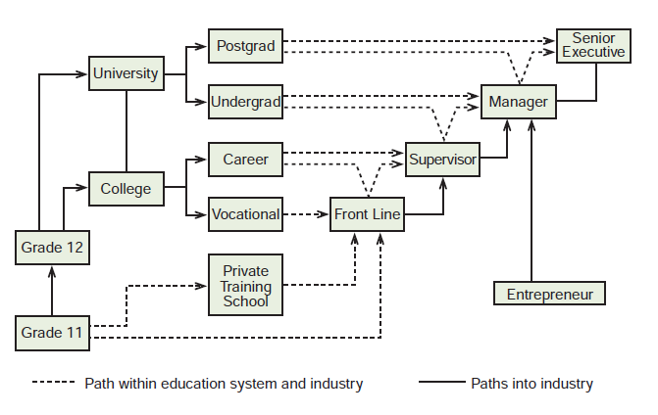
Career pathway

Slide 5
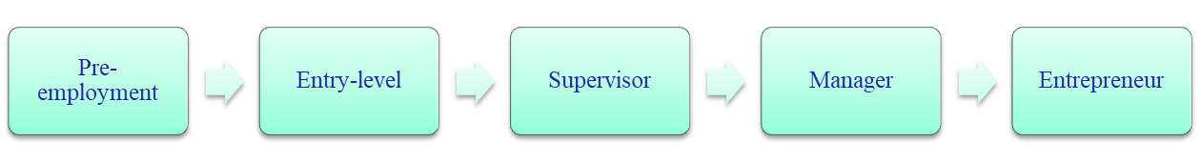
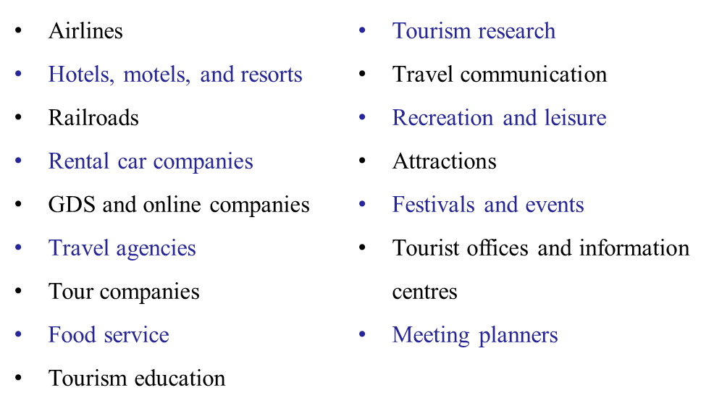
Career
Career path
Career possibilities

Slide 6
